Slide 1

Capital Budgeting Methods Used in Some European Countries and in the United States
Author: Klara Szűcsné Markovics
Presented By:
Lalit Raj Joshi
Nisha Rouniar
Rashik Parajuli
Sulav Poudel

Slide 2
Agenda for discussion
Introduction
Objective
Methodology Used
Key Findings
Conclusions
Group 3

Slide 3
Introduction
Author: Klara Szűcsné Markovics, Faculty of Economics, University of Miskolc, Hungary
Journal: Universal Journal of Management
Publication Date: 2016
Article Background:
  The paper reviews capital budgeting techniques used by corporate decision-makers in Europe and the United States.
  It compares empirical findings across countries and includes original survey results from Hungary.
  Motivation arises because investment decision methods differ across countries, industries, and firm sizes, and research findings are often inconsistent.
  Focuses on identifying the most frequently applied indicators in practice.

Slide 4
Objective of the Study
Main Objective:
To provide a comprehensive review and comparison of capital budgeting methods used by corporate managers in Europe and the US.
Specific Objectives:
Identify the most commonly used investment appraisal techniques.
Compare practices across countries and regions.
Examine empirical findings from international surveys and Hungarian research.
Focus on five major indicators:
  Payback Period
  Accounting Rate of Return
  Internal Rate of Return
  Net Present Value
  Profitability Index

Slide 5
Methodology
1. Population: The population considered in the article comprises corporate managers and business firms, examined through empirical studies conducted across Europe, the United States, and Hungary. These studies focused on decision-makers responsible for capital budgeting and investment evaluation practices.
2. Sample: Sample sizes varied:
  Some studies had hundreds of respondents
  Others fewer than 100
  Response rate: 22.1%
  Hungarian empirical study
    Sampling method: Stratified sampling based on turnover categories
    Firms contacted: 1500 total
      Postal questionnaires: 500
      Online/email distribution: 1000
    Usable responses: 76
    Response rate: 5.1%

Slide 6
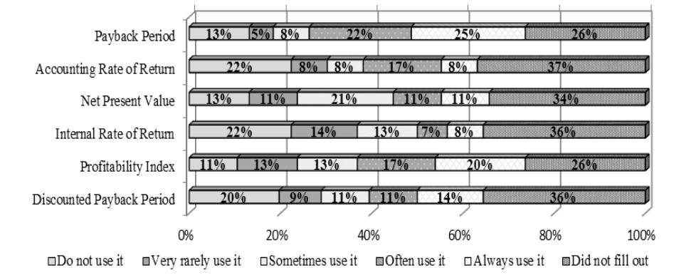
Methodology..(cont)
Figure 1. Indicators most frequently used for evaluating the economic efficiency of investments in Hungary

Slide 7
Methodology..(cont)
3. Data Collection & Sources
Primary Data: Structured questionnaires distributed through:
      Postal mail
      Online/email hyperlinks
      Follow-up telephone contact used in some cases to increase response rates
  Target respondents:
    Financial managers
    Corporate decision-makers responsible for investment planning
Secondary Data
  Findings from previous empirical research studies across multiple countries
  Published survey results and academic literature on capital budgeting practices
Time Structure
  Data collection conducted as cross-sectional surveys
  Example: Hungarian survey carried out in summer 2012

Slide 8
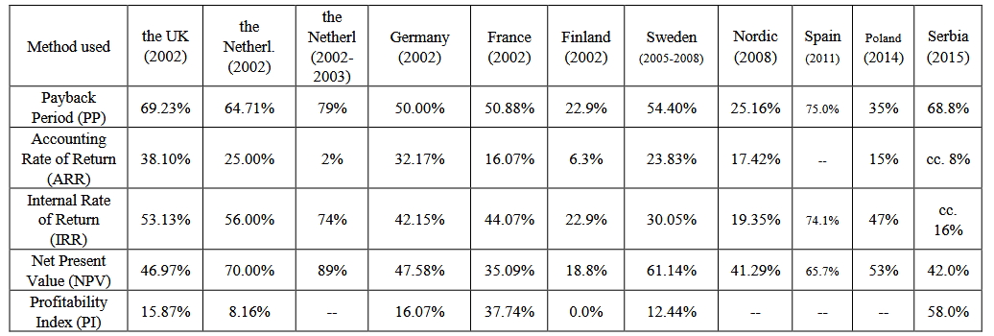
Methodology..(cont)
4. Tools & Techniques for Analysis
The article and referenced studies applied several analytical approaches:
Descriptive statistical analysis
  Frequency distribution
  Ranking of capital budgeting methods
  Usage comparison across firms
Comparative cross-country analysis
  Benchmarking practices between Europe and the US
  Evaluating methodological differences
Multivariate regression analysis
  Used in referenced studies to examine factors influencing method selection
Spreadsheet/statistical software processing
  Aggregation and tabulation of survey responses

Slide 9
Methodology (Overview)
1️⃣ Payback period remains widely used across Europe and the US despite theoretical limitations.
2️⃣ Net Present Value (NPV) and Internal Rate of Return (IRR) are the most frequently applied discounted cash-flow techniques.
3️⃣ Preferences vary by country — e.g., profitability index used more in France and Hungary.
4️⃣ Larger firms tend to use sophisticated methods like NPV and IRR more than small firms.
5️⃣ Manager characteristics (education, experience) and firm features influence method selection.

Slide 10
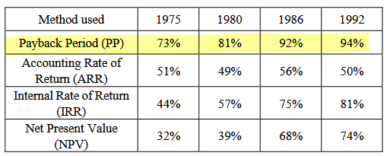
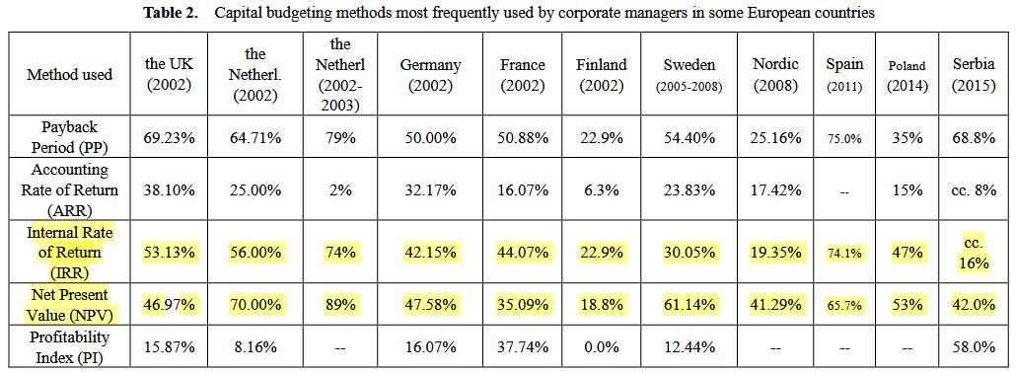
Key Findings
1. Payback period remains widely used across Europe and the US despite theoretical limitations.
2. Net Present Value (NPV) and Internal Rate of Return (IRR) are the most frequently applied discounted cash-flow techniques.

Slide 11
Key Findings
3. Preferences vary by country, i.e., the profitability index is used more in France and Hungary.
4. Firm size significantly influences method selection:
  Small firms tend to use non-discounted methods.
  Large corporations prefer discounted techniques such as NPV and IRR.
5. The use of advanced capital budgeting methods is higher in firms with:
  Better-qualified financial staff
  Larger size
  Stock exchange listing
  Higher leverage and growth opportunities

Slide 12
Limitations of the Study
Heterogeneity in research methodologies across reviewed studies.
Differences in sample size and sector representation.
Low questionnaire response rates in some surveys.
Lack of standardization in defining and calculating indicators.
Cross-country variations limit direct comparability.
Some studies focused only on selected indicators, not all methods.

Slide 13
Conclusion
Capital budgeting practices differ across regions and firms.
Traditional and modern methods coexist in decision-making.
Discounted cash-flow techniques are gaining importance but simpler methods remain popular.
Firm size, market conditions, and managerial background shape method choice.

Slide 14
Conclusion Considering Nepal
Nepalese firms, especially SMEs, largely rely on simple methods like Payback Period due to limited analytical resources.
Adoption of advanced techniques such as NPV and IRR could significantly improve investment decision quality.
These methods are particularly important for capital-intensive sectors in Nepal (hydropower, infrastructure, tourism, agro-processing).
Financial literacy, managerial training, and education need strengthening to support better capital budgeting practices.
Promoting structured investment appraisal and further Nepal-focused research can enhance long-term financial sustainability and economic development.

Slide 15
“Business opportunities are like buses. There’s always another one coming.”
Richard Branson

Slide 16




Thank you
Group 3
Symphony

